Slide 1
PRÉ-PROJETO
Carrinho controlado por gestos

Slide 2
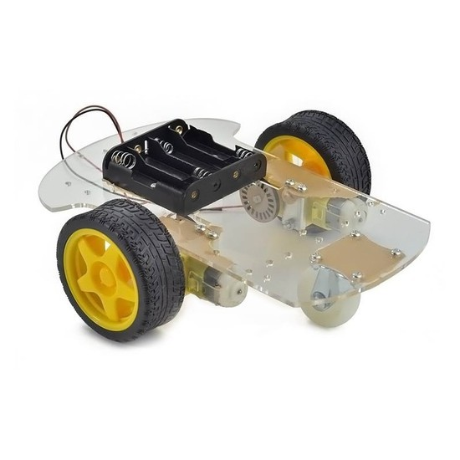
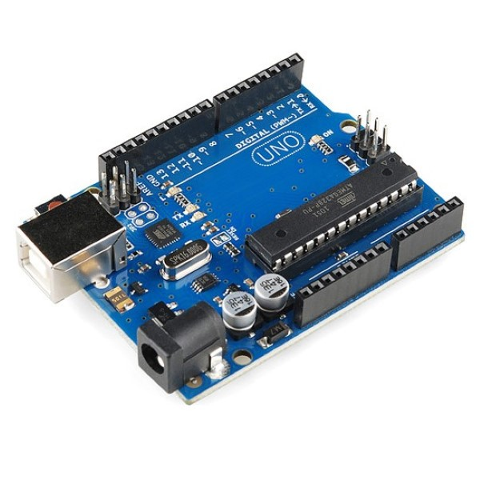
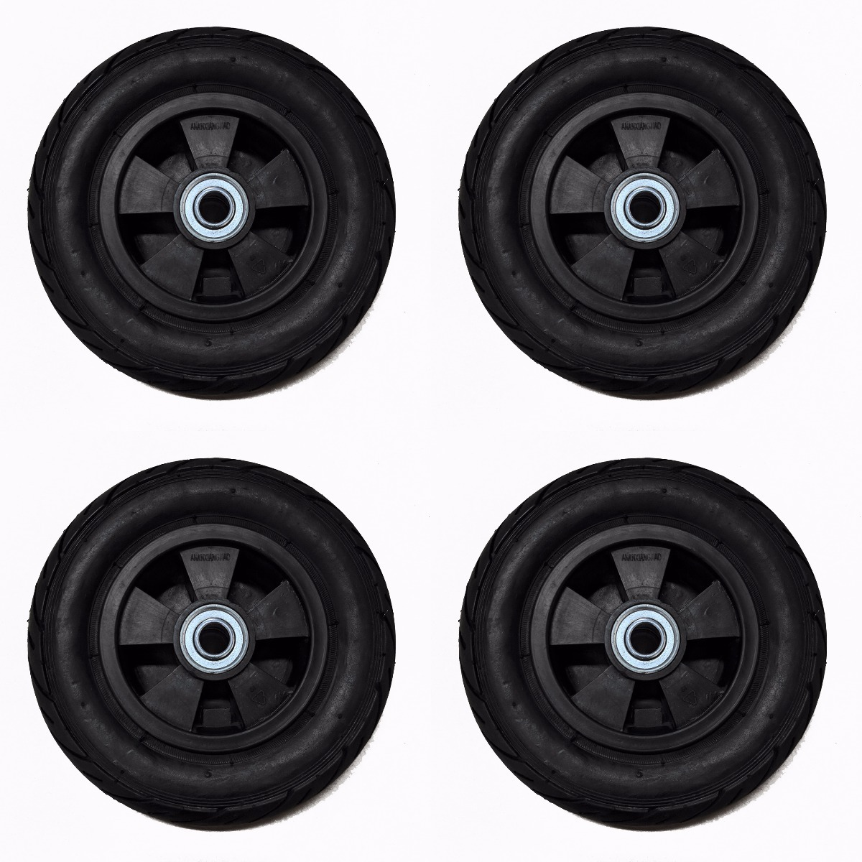
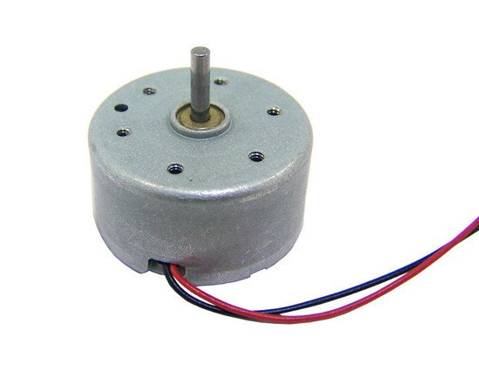

IDEIA PASSO 1:

Slide 3
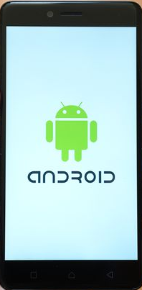
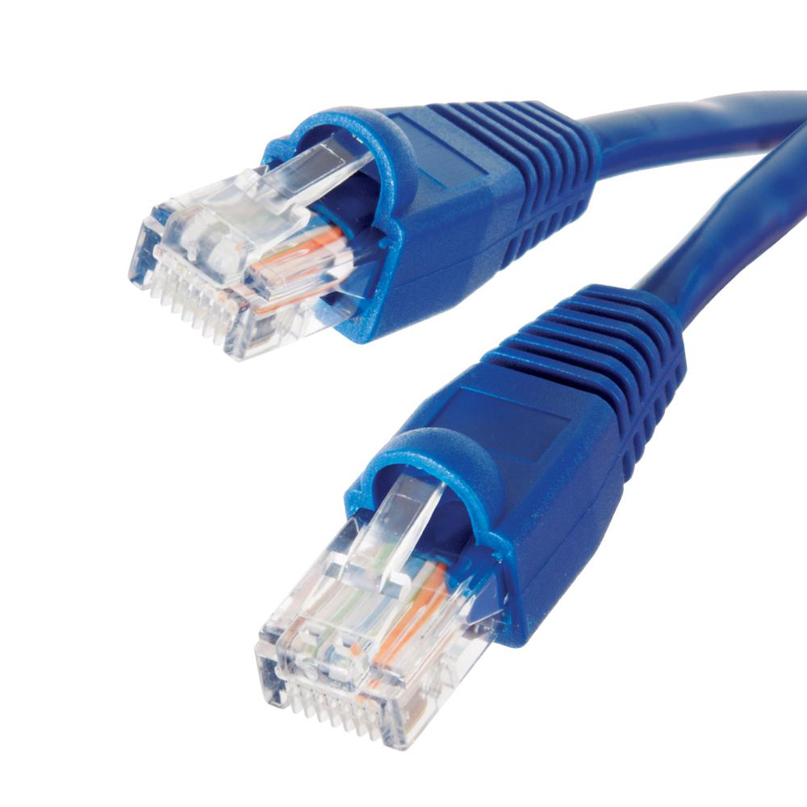
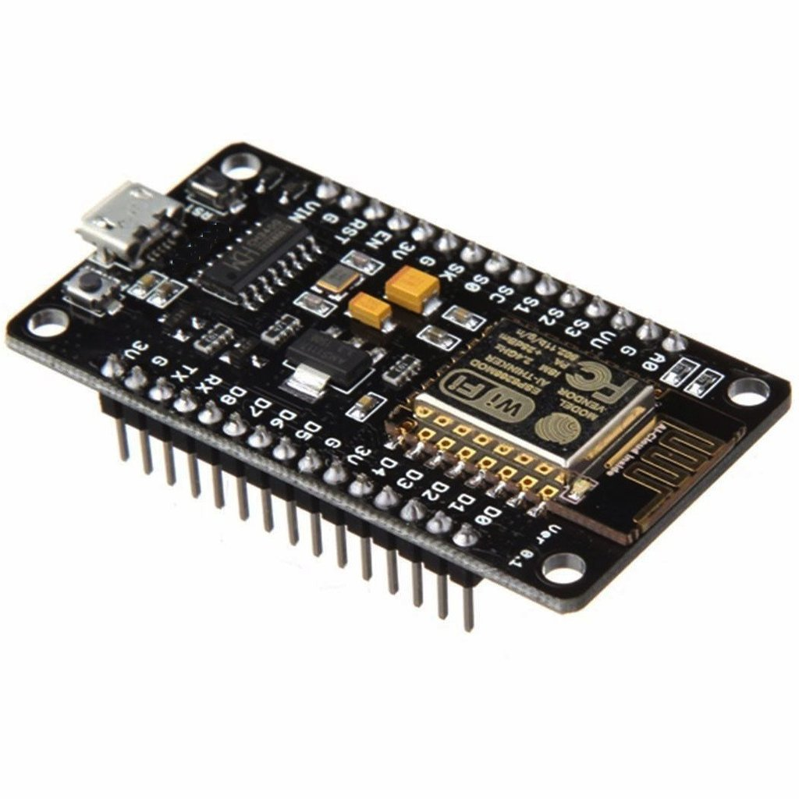

IDEIA PASSO 2:

Slide 4
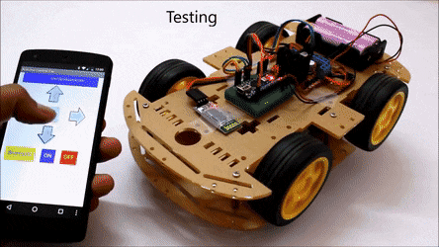
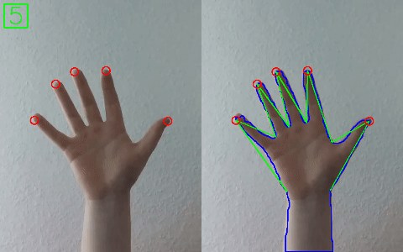
IDEIA PASSO 3:

Slide 5
REFERÊNCIAS
https://towardsdatascience.com/build-hand-gesture-recognition-from-scratch-using-neural-network-machine-learning-easy-and-fun-d7652dd105af
https://www.tensorflow.org/lite/models/pose_estimation/overview
https://towardsdatascience.com/handtrackjs-677c29c1d585
https://medium.com/@muehler.v/simple-hand-gesture-recognition-using-opencv-and-javascript-eb3d6ced28a0

